Slide 1
The Traffic Sign Recognition and Training (TSRT)
Group 2

Slide 2
Team Member
Supervisor: Kiều Trọng Khánh
Mai Văn Tân
Bùi Việt Phong
Hồ Đắc Nghĩa (drop out)
Trần Lê Tuấn (drop out)

Slide 3
Outline:
Scenario Problem
Current solution
Propose our solution
Technology and development environment
Demonstration
Advantages and Disadvantages
Future Plan

Slide 4
Scenario Problem
In Vietnam, we have more than 200 traffic signs
Many traffic signs is not familiar
⇨ Cause difficult to people when join in traffic

Slide 5

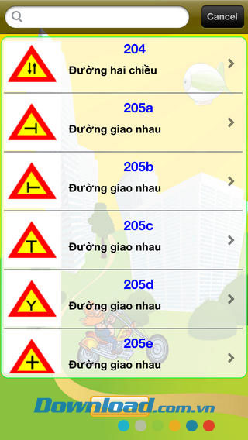

Current solution

Slide 6



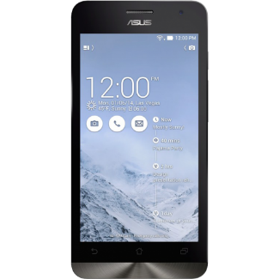
Propose our solution

Slide 7
Features
Recognition
Mobile Application
More and update information
Sync data
Learning

Slide 8
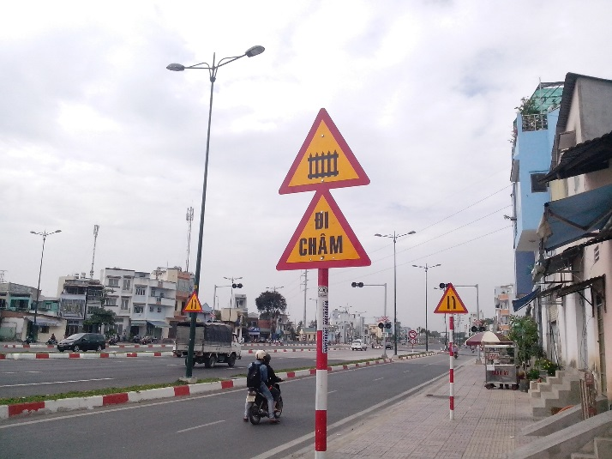
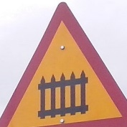
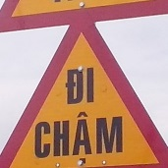

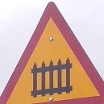

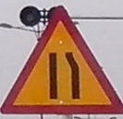
How to detection and recognition work
Image
Detect
Detected Area
Start
Traffic sign
Recognize
Finish
210
245
203c

Slide 9
Technology and development environment

Slide 10
Definitions
Search auto: search traffic sign using image file or camera.
Train Image: Image use to train the system to recognize traffic sign.
Model: Data result of train process, use to recognize traffic sign.

Slide 11
Demonstration
Search auto in many conditions
Fix wrong recognize
Offline search
Sync favorite
Add new traffic sign

Slide 12
Advantages and Disadvantages
- Automatically
- Fast
- Support learn
- Need internet connection
- The accuracy not reach 100%

Slide 13
Future Plan
Improve detection and recognition accuracy
Support more platform (iOS, Windows phone)
Support more traffic sign types
Public to end user

Slide 14
Q&A

Slide 15
Thank you

